Slide 1
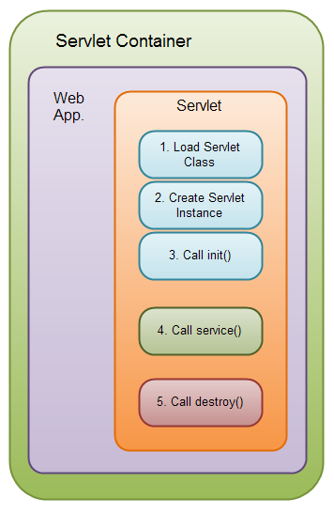
Life Cycle of a Servlet (Servlet Life Cycle)
The web container maintains the life cycle of a servlet instance.
Servlet class is loaded.
Servlet instance is created.
init() method is invoked.
service method is invoked.
destroy method is invoked.

Slide 2
1) Servlet class is loaded:
The classloader is responsible to load the servlet class. The servlet class is loaded when the first request for the servlet is received by the web container.
2) Servlet instance is created:
The web container creates the instance of a servlet after loading the servlet class. The servlet instance is created only once in the servlet life cycle.
3) init method is invoked:
The web container calls the init method only once after creating the servlet instance. The init method is used to initialize the servlet.
Syntax: public void init(ServletConfig config) throws ServletException
4) service method is invoked:
The web container calls the service method each time when request for the servlet is received.
Syntax: public void service(ServletRequest request, ServletResponse response)throws ServletException, IOException
5) destroy method is invoked:
The web container calls the destroy method before removing the servlet instance from the service. It gives the servlet an opportunity to clean up any resource for example memory, thread etc.
Syntax: public void destroy()

